Slide 1
AIR SAMPLING
TO MEET THE U.S. OSHA FINAL RULE ON RESPIRABLE CRYSTALLINE SILICA

Slide 2
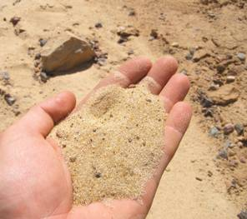

What’s the big deal about silica?
The extremely small respirable silica particles can get deep into the lung producing serious health effects:
Lung disease including silicosis, tuberculosis, and cancer
Kidney disease
Lupus and rheumatoid arthritis

Slide 3

What’s the big deal about the 2016 osha standard for silica?
New permissible Exposure Limit (PEL):
  U.S. OSHA significantly reduced (cut in half) the amount of silica that workers can be exposed to over the 8-hour workday. Employers must ensure that no employee is exposed to a concentration of silica in excess of 50 micrograms of silica/cubic meter of air (µg/m³) calculated as an 8-hr time-weighted average (TWA).
An action level of 25 µg/m³ was also set by OSHA.
So how can you comply?

Slide 4
IF YOU WORK IN THE
CONSTRUCTION INDUSTRY
Consult the table on the following slide for help with compliance.
Good news: Allows employers to use specified dust control measures instead of air sampling for defined work tasks.
Not so good news: Only 18 tasks/control measures are listed as of 2018. OSHA plans to expand.

Slide 5
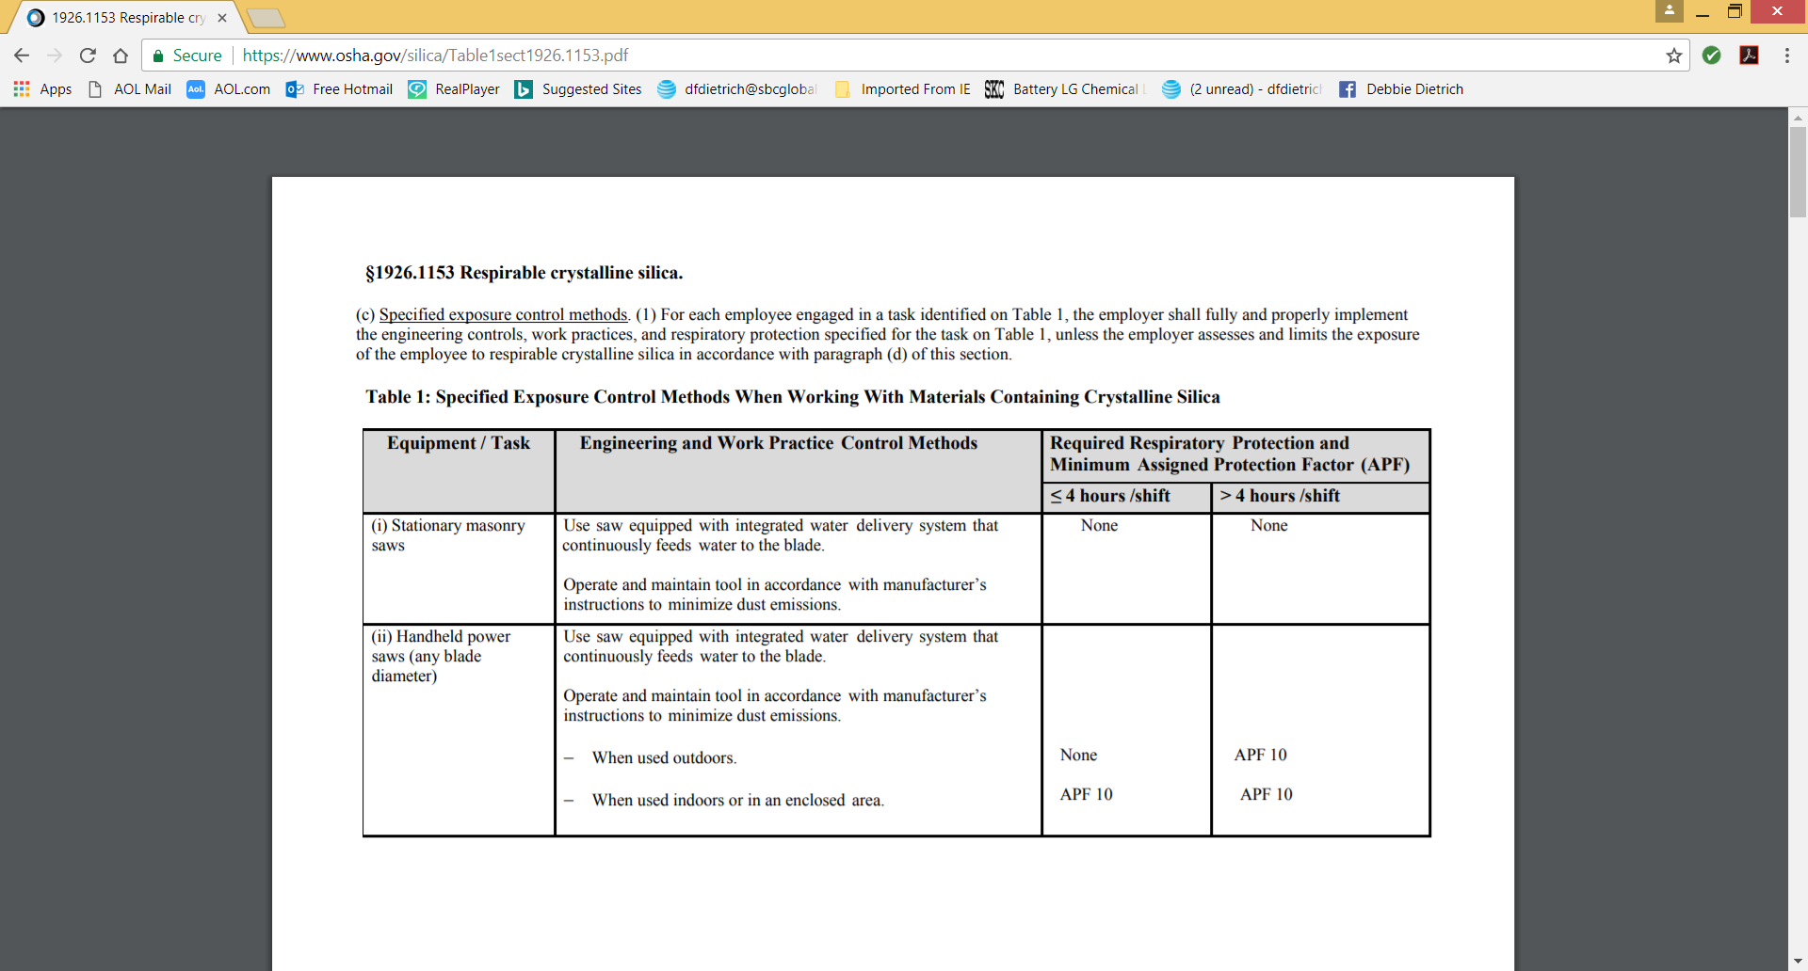
EXCERPT FROM TABLE 1

Slide 6
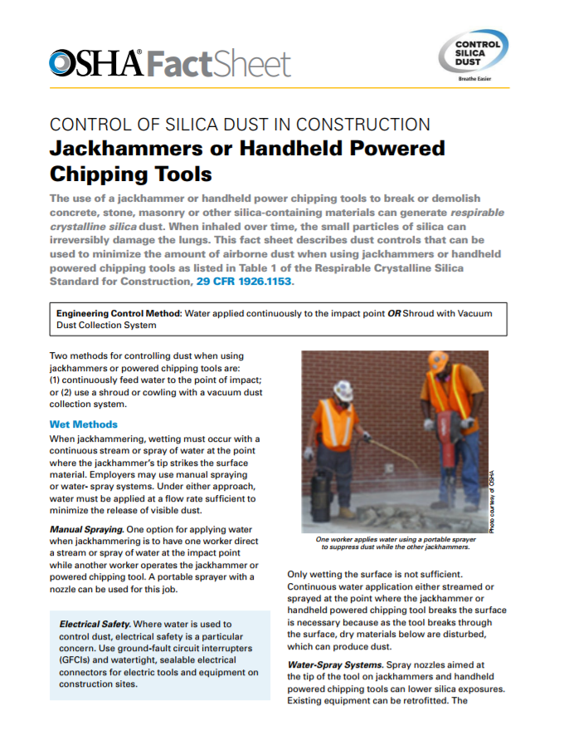
FACT SHEETS FROM OSHA https://goo.gl/pLhJPa
On Controlling Silica Dust for Table 1 Tasks
Handheld Power Saws Fact Sheet
Handheld Grinders for Tasks Other Than Mortar Removal Fact Sheet
Handheld Power Saws Used to Cut Fiber-Cement Board
Jackhammers or Handheld Powered Chipping Tools Fact Sheet
Handheld and Stand-Mounted Drills Fact Sheet
Stationary Masonry Saws Fact Sheet
Handheld Grinders for Mortar Removal (Tuckpointing) Fact Sheet
Walk-Behind Saws Fact Sheet
Drivable Saws Fact Sheet
Rig-Mounted Core Saws or Drills Fact Sheet
MORE AVAILABLE

Slide 7
IMPORTANT CONSIDERATION
IF USING TABLE 1 OPTION
Keep in mind that in 1926.1153(h)(1)(i) OSHA requires medical surveillance for any employee that wears a respirator for more than 30 days per year.
Medical surveillance must include:
Medical/work history
Physical exam
Chest X-ray
Pulmonary function test
TB test
Re-exam at least every 3 years
Air sampling may be less costly for employers.

Slide 8
IMPORTANT CONSIDERATION
FOR ALL EMPLOYERS
All employers covered by the standard, including employers who fully and properly implement exposure controls in Table 1, must develop and implement a written exposure control plan.
Employers must also designate a competent person to implement the plan, evaluate its effectiveness, and update it as necessary with new tasks, new tools, and new control measures that are in use.

Slide 9
Exposure control plan what must be included
Description of workplace tasks where there could be silica exposures including equipment used, materials handled, typical weather conditions, outdoors vs indoor work.
Description of engineering controls, work practices, and respiratory protection used to limit exposures.
Instructions from equipment manufacturers on how to decrease dust and signs that control measures are not working properly such as an increase in visible dust.

Slide 10
Exposure control plan what must be included
Acceptable cleaning methods that can be used to prevent employees from being exposed to silica dust and any hygiene-related matters such as not using compressed air to clean your clothing.
Description of procedures to restrict access to work areas such as scheduling tasks when others are not around, limiting access to the work area, moving employees to an area where they are not exposed to the dust cloud, posting warning signs.

Slide 11
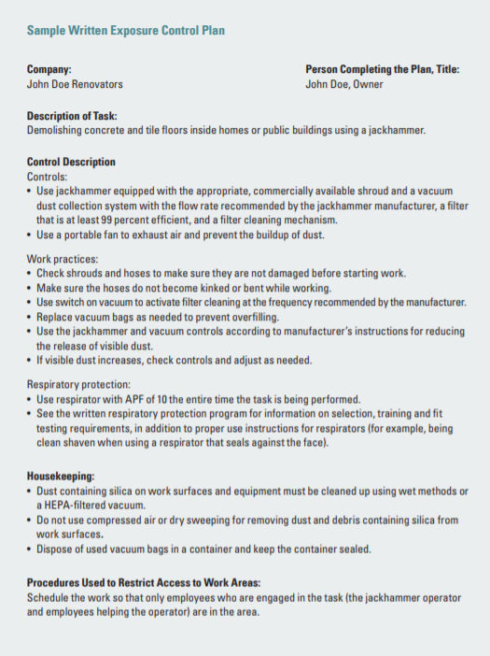
NEED HELP?
Consult the OSHA Small Entity Compliance Guide for a Sample of an Exposure Control Plan at: https://www.osha.gov/Publications/OSHA3902.pdf

Slide 12
IF NOT USING TABLE 1
TO CONTROL EXPOSURES
OSHA requires employers to assess the exposures of each employee who is or may be potentially exposed to silica at or above the action level of 25 ug/m³.
How?
(a) Performance Option or
(b) Scheduled Monitoring Option

Slide 13
Details on performance option
Allows employers to assess the 8-hour TWA exposure based on any combination of air monitoring data or so-called objective data.
Objective data includes typical exposure levels documented in industry-wide surveys, historical data you may have on file, calculations based on chemical composition of a substance in use, etc.
Objective data must closely reflect the work conditions at your site and the burden is on the employer to demonstrate the objective data being used is applicable to your site/job.

Slide 14
Where can you find objective data?
Do an internet search:
Manufacturers of drilling and grinding equipment such as Makita and Hilti provide data for their tools.
Trade Associations such as the Construction Employers Association and Associated General Contractors (AGC) provide opportunities for members to post and share data.

Slide 15
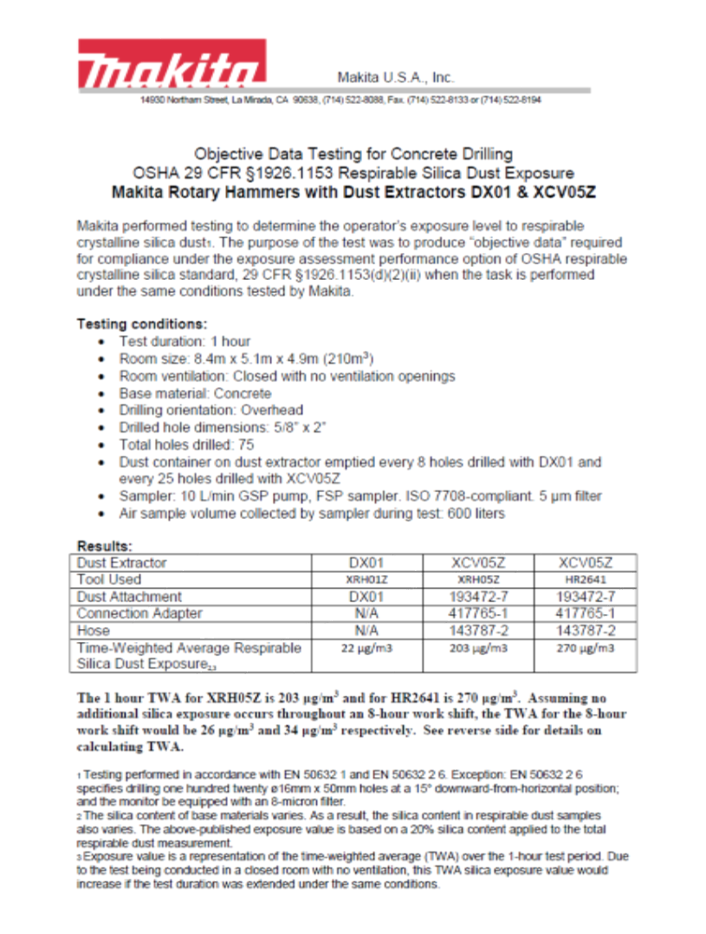

Slide 16
Details on
Scheduled monitoring option
Initial air monitoring must be done unless employers can objectively demonstrate there is no silica released above the action level.
More monitoring may need to be done to reassess levels:
  If above PEL – Control the hazard; Re-assess every 3 months
  If above Action Level - Re-assess exposures every 6 months
  Reassess when there are changes to production, process, control equipment, personnel, or work practices that could produce exposures greater than the action level.
  Discontinue monitoring when 2 consecutive measurements, 7 days apart are less than the action level.

Slide 17
more on Scheduled monitoring option:
HOW MANY SAMPLES ARE REQUIRED?
OSHA says to collect one or more personal breathing zone samples that reflect exposures on each shift, each job classification, and each work area.
If several employees do the same tasks, in the same shift, in the same work area, you can do representative sampling, by sampling those with the highest exposures.
Notes:
One of the big questions that health and safety professionals face when sampling ANY air contaminant is HOW MANY SAMPLES to take to adequately assess exposures. OSHA provides some guidance on this in the silica standard:
-OSHA says to collect one or more samples that reflect each shift, each job classification, and each work area.
-If several employees do the same task, in the same shift, in the same work area, you don’t have to sample every single one.
Simply select the employees with the highest potential exposures as a representative sample.

Slide 18
MORE ON THE PERMISSIBLE EXPOSURE LIMIT (PEL)
HOW MUCH SILICA DUST IS 50 µg/m³?
Imagine a pile of dust the size of a standard pencil eraser. This amount of dust in a box 3 ft X 3 ft X 3 ft would be over the current PEL of 50 µg/m3.
WHAT ABOUT ANALYSIS?
OSHA now requires that the lab analyze for all (3) forms of silica including quartz, cristobalite, and trydymite.
Trydymite is normally only associated with volcanoes. So talk to your lab about analysis of this form of silica.

Slide 19
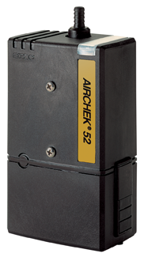
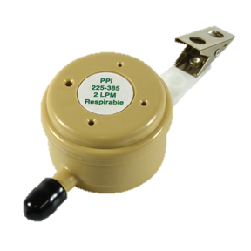
air Sampling for silica easy as 1-2-3
1
2
3

Slide 20
THREE KEY COMPONENTS
FOR silica SAMPLING
1. Sampling pump
Pulls air through the sample collection device
2. FLOWMETER (CALIBRATOR)
Measures the flow rate of the pump with a high degree of accuracy. A readout of the flowrate on the pump itself is not accurate enough without calibration.
3. Sample collection device
Separates and collects the small respirable dust particles from the dust cloud onto the filter for lab analysis of silica

Slide 21
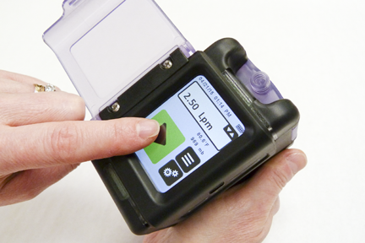
FIRST KEY COMPONENT
SAMPLING PUMP

Slide 22
CHOOSING YOUR SAMPLING PUMP
FACTORS TO CONSIDER
FLOWRATE- Can the pump sample at the flowrates required for respirable dust samplers (typically 2 L/min or higher)?
POWER- Can the pump continue to sample at a constant flowrate for 8 hours even with high dust load on the filter?
SIZE AND WEIGHT- Will the pump be acceptable for workers to wear for the full shift?
AUTOMATIC FEATURES- Do you want a basic pump or are you willing to pay for touchscreen, timers, programming options, PC compatibility?

Slide 23
INEXPENSIVE, BASIC PUMP
FROM SKC
AIRCHEK 52
Flow range up to 3 L/min
On/off switch and flow adjustment screw
Maintains constant flow
Timer keeps track of sample time
No programmability
Available in a basic silica kit with required accessories.

Slide 24
Advanced pump from skc
AIRCHEK TOUCH
Flow range up to 5 L/min
Intuitive touch screen to set and monitor pump functions and flowrate.
Optional software to set up pump functions/flowrate and to document pump history in the field.
Available in a deluxe silica kit with required accessories.

Slide 25
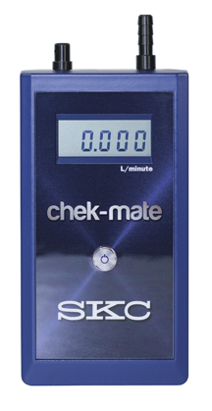
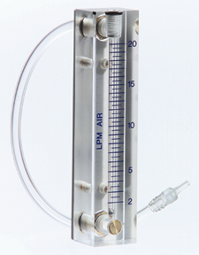
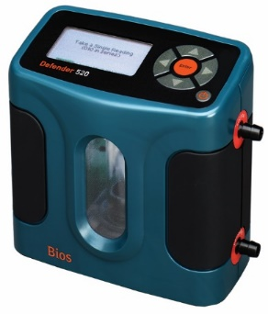
SECOND KEY COMPONENT
CALIBRATOR (FLOWMETER)

Slide 26
PUMP CALIBRATION
CLARIFICATION
The term calibration can be confusing to those who are new to air sampling.
Calibration of pumps does not refer to an annual service that is done by the factory.
Pump calibration means that you the user set and verify the flowrate of the pump to that required in the sampling procedure.
This must be done before and after every sample that you take.
The average of the pre- and post- sample flowrates is used to calculate the air volume.

Slide 27
PUMP CALIBRATION: why you have to do it
You must calculate total air volume for each sample and report this to the laboratory when you submit your samples (filters) to them.
The laboratory will use the total air volume you provided to calculate airborne concentration levels of silica for each sample.

Slide 28
PUMP CALIBRATION: how its used
The pump flow rate measured by your pump calibrator is multiplied by the total sampling time.
Flow rate (L/min) X Time (min)=Air Volume (L of air)
This air volume is sent by you to the laboratory with each one of your samples.
The lab will then measure the amount of silica on the filter and will use the air volume you supplied to calculate micrograms/m³ of silica in the air.

Slide 29
It is important to have a high accuracy calibrator
Everyone doing air sampling should have at least one calibrator of high accuracy that is recertified annually to a national standard (NIST) by a ISO calibration laboratory.
Fee for annual recalibration by SKC Cal Lab is only $195.
You may also want some less expensive field devices (such as rotameters) that you can calibrate yourself by comparing the flow indication on the rotameter to that of your high accuracy, certified calibrator.

Slide 30
High accuracy calibrator from skc
CHEK-MATE
Simple, One-button operation
Takes a reading once/second and displays a moving average of the flowrates
Flow range up to 5 L/min covers the range for silica sampling
Included in the SKC Deluxe Silica Sampling Kit or sold/rented separately

Slide 31
Inexpensive calibration option rotameters
Rotameter
Pump flowrate draws the float ball to a L/min indication on the rotameter scale
Can be easily transported in the field (or used in the office).
Included in the SKC Basic Silica Kits
It is standard practice to check rotameters “regularly” against the high accuracy certified calibrator to ensure the flow indication is accurate.
Suggestion: Check rotameters once/month.

Slide 32
TECH TIPS ON CALIBRATION
Remove the pumps from the battery charger and let pumps run about 5 minutes before calibration to let the flow stabilize.
Attach the sample collection device to the pump with connecting tubing. This sample collection device will be used for calibration only.
Attach the calibrator to the sample collection device. Turn on the pump and measure the flowrate.
Attach a clean sample collection device to collect the sample in the field.
After sampling, recalibrate the pump using the sample collection device for calibration to avoid contaminating the sample from the field.
Some people post-calibrate with the sampler from the field attached to the pump. But this is not necessary if you are using a good quality constant flow pump.

Slide 33
TECH TIPS ON CALIBRATION
5% is a popular number
Ensure the pump flowrate is within ±5% of the specified flowrate for your sample collection device.
Use the running average from the SKC Chekmate or take at least 3 flow measurements that agree within 5% with other calibrator types and use the average as your flow rate measurement.
If your pre-and post- sample flowrates differ by more than 5%, your sample is called into question and should be repeated.

Slide 34
TECH TIP IN CALIBRATION
SET-UP
Don’t get confused.
Set up the pump and sample media like its ready to place on the worker.
Then attach the inlet of the sample media to the calibrator to check the flowrate.

Slide 35
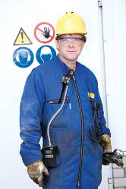
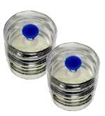
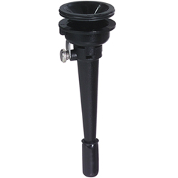
THIRD KEY COMPONENT
SAMPLE COLLECTION DEVICE

Slide 36
So how do we sample respirable silica dust?
Respirable silica dust is ultimately collected onto a PVC filter for laboratory analysis.
Preceding the filter, however, is a particle size-selective device that will separate the smaller, respirable dust particles from the larger, non-respirable dust when connected to a pump sampling at the designated flow rate.

Slide 37
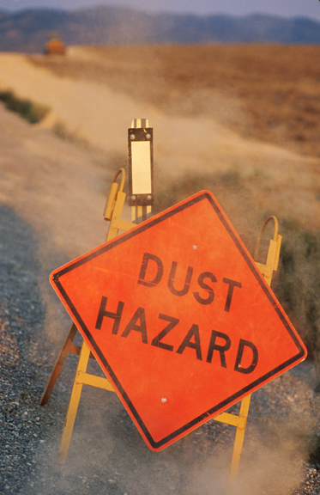
OSHA ADOPTED NEW CRITERIA FOR RESPIRABLE DUST SAMPLERS
Respirable crystalline silica samplers must meet the performance criteria specified in ISO 7708.
ISO 7708 is also referred to in the OSHA silica rule as the ISO/CEN convention.
ISO=International Standards Organization.
CEN=Committee for European Normalization.

Slide 38
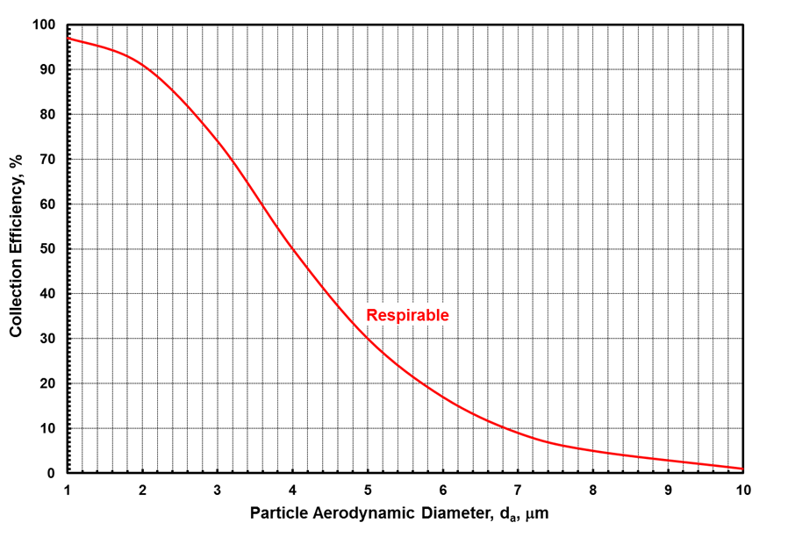
ISO 7708 SPECIFICATIONS
FOR RESPIRABLE DUST SAMPLERS
The ISO 7708 performance criteria is essentially a collection efficiency curve that specifies the efficiency of the sampler for particles of designated sizes.

Slide 39
OF PARTICULAR NOTE:
THE 50% CUT-POINT
A common term used in sampling.
This is the particle size that the sampler collects with 50% efficiency.
ISO 7708 specifies a 50% (median) cut-point of 4 um.

Slide 40
RESPIRABLE DUST SAMPLERS:
TO MEET OSHA CRITERIA IN
THE FINAL RULE
Option #1: Cyclones

Slide 41
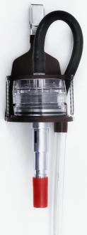
CYCLONE OPERATION
Cyclones are inserted into filter cassettes containing PVC filters and are attached to sample pumps.
Air enters through a slit on the side of the cyclone which creates cyclonic action.
Through centrifugal force, large particles fall into the cap at the bottom called a “grit pot” and are discarded.
Small particles are thrown onto the filter for analysis.
Cap must be in place during sampling!
Air

Slide 42
MORE ON CYCLONE OPERATION
After sampling, the cyclone is removed and the filter is capped and sent to the lab.
DON’T TURN THE CYCLONE UPSIDE DOWN UNTIL YOU HAVE REMOVED THE FILTER!! If the large particles in the cap at the bottom get dumped onto your filter, your sample is invalid (and the results will look very high).
Clean the cyclone with soap and water between every use or the dust stuck to the interior walls of the cyclone will affect your results.

Slide 43
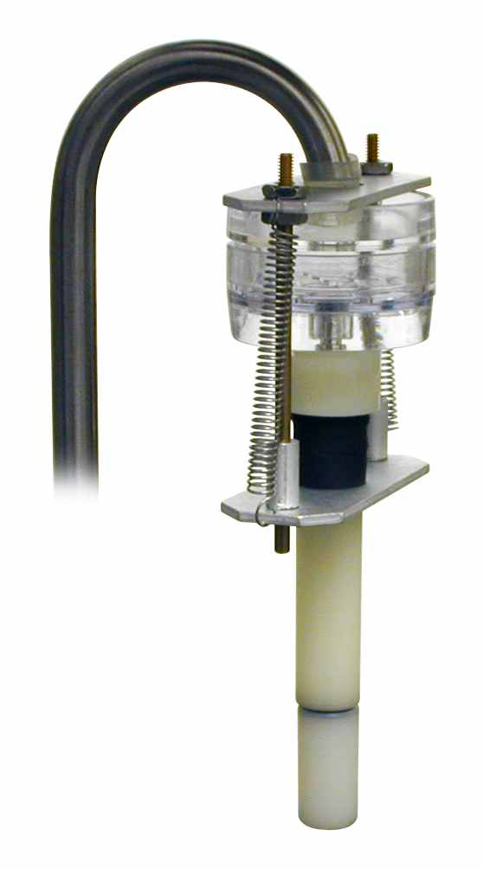
OLDER CYCLONE SAMPLERS
TO MEET OSHA CRITERIA
10-mm NYLON DORR-OLIVER CYCLONE
  U.S. OSHA inspectors have been using this cyclone since OSHA began in the 1970s.
  But the new OSHA standard allows employers to use any sampler that meets the OSHA criteria. (ISO 7708)
Used at 1.7 L/min

Slide 44
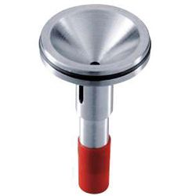
NEWER CYCLONE SAMPLERS
TO MEET OSHA CRITERIA
SKC ALUMINUM CYCLONE
Listed in OSHA Final Rule on page 16439 of 29CFR 1910
Used at 2.5 L/min to meet OSHA criteria
SKC 225-01-02 (37-mm)

Slide 45
SKC ALUMINUM CYCLONE
ADVANTAGES
Metal construction eliminates static electricity concerns.
Larger collection area. The cyclone is inserted into the middle ring of a 3-piece filter cassette.
Calibration adapter offers user convenience.

Slide 46
SKC GS-3 CYCLONE
Originally designed for coal mines since aluminum (and other alloys) can not be taken into an underground mine
Conductive plastic construction eliminates static electricity concerns
Not a spark hazard for coal mines
Designated flow rate is 2.75 L/min to meet OSHA criteria
.
SKC 225-100 (37-mm)

Slide 47
IMPORTANT NOTE ON FLOWRATE
All cyclones are not created equal!
Each cyclone has different operating specifications to meet the required performance criteria.
Be sure you know the flow rate specified before using any cyclone.

Slide 48
If you use the wrong flowrate data collected is meaningless
1.7 L/min
Nylon
Dorr-Oliver
2.5 L/min
SKC Aluminum
2.75 L/min
SKC GS-3

Slide 49
RESPIRABLE DUST SAMPLERS
TO MEET ISO 7708 & OSHA CRITERIA
New Options

Slide 50
NEW SAMPLERS
FOR ISO 7708 & OSHA CRITERIA
On Page 16439 of the final rule on silica (29CFR 1910), OSHA notes:
The new silica rule “will permit employers to use ANY
sampling device that conforms to the ISO/CEN
convention”.

Slide 51
NEW SAMPLERS
FOR ISO 7708 & OSHA CRITERIA
Page 16439 goes on to say that in addition to traditional cyclones:
“There are also personal impactors available for use at flowrates from 2 to 8 L/min that have been shown to conform closely with the ISO/CEN convention”.
This data was supplied by SKC to the OSHA docket on new PPI samplers.

Slide 52
HERE’S THE PROOF

Slide 53
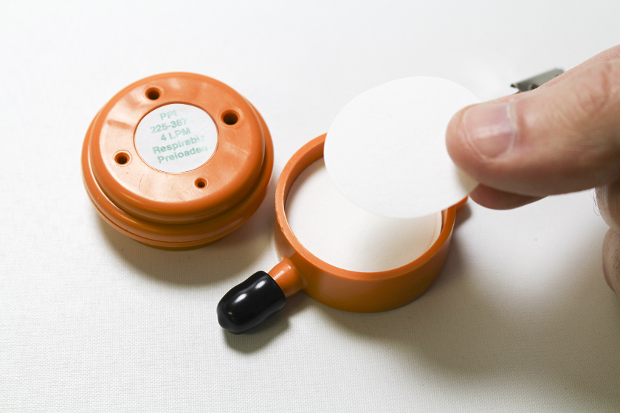
DISPOSABLE IMPACTORS
SKC PPI SAMPLERS
Instead of a cyclone, PPI impactors have 4 internal, pre-oiled plates that scrub out larger particles. The impactor plates are sonically welded into place by SKC and require no assembly.
The pump draws the air into the PPI. Larger particles are scrubbed out onto the plates and the smaller respirable dust is collected onto the PVC filter for analysis as usual.
Same filter and same analysis as with cyclones. ONE TIME USE.

Slide 54
PPI SAMPLER PERFORMANCE
COMPARED TO ISO/OSHA CRITERIA
Perfect Match!

Slide 55
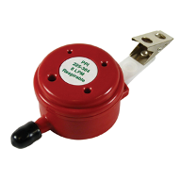
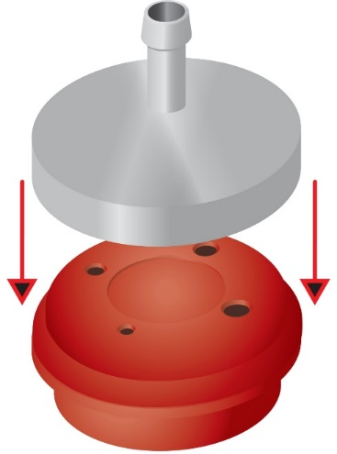
MORE PPI ADVANTAGES
CONVENIENCE
A handy calibration adapter is available to attach the PPI to the calibrator (flowmeter).
No calibration jar is needed.

Slide 56
MORE PPI ADVANTAGES
SAMPLE INTEGRITY
No tipping hazard. You can invert the sampler without causing large particles to land on the filter invalidating the sample.
Assembly. Let’s look at cyclones versus the PPI.

Slide 57
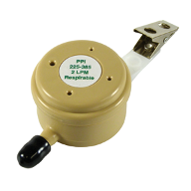
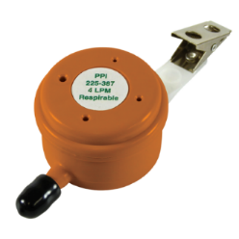
SKC RESPIRABLE PPI
FLOWRATE OPTIONS
Single-use, disposable PPI models are available for use at either 2, 4, or 8 L/min.
This allows some flexibility in sample duration.
2 L/min
8 L/min
4 L/min

Slide 58
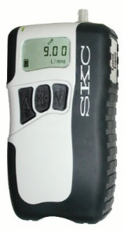
ppi
FLOWRATE OPTIONS
By far, the number one most popular PPI model is the one designed for use at 2 L/min.
If you want to sample a shorter duration, you could consider the option of using the 4 L/min PPI (SKC 225-3871) or 8 L/min PPI.
Keep in mind, you will need sampling pumps that can achieve these flowrates.

Slide 59
PPI: NOT JUST FOR silica for any respirable dust
Like a cyclone, the PPI can be used for sampling any type of respirable dust.
For sampling respirable dust followed by gravimetric analysis (weighing the filter), you will need to use a PPI with PRE-WEIGHED filters now available from SKC or your lab.

Slide 60
IMPORTANT CONSIDERATIONS
FOR SAMPLE DURATION
Full-shift sampling is the best option since the PEL is an 8-hr limit. But listed below are some considerations for shorter term sampling.
In OSHA’s general industry standard for silica, OSHA provides some guidance on how long to collect the sample so the lab will have enough silica on the filter to actually measure it.
Table VII-7 on page 16440 suggests a minimum sample time of 4 hours using a sampler at 2 L/min in dust concentrations near the action level.

Slide 61
Laboratory recommendations on sample duration
Even though OSHA feels 4 hours may be the minimum sample time for adequate detection of silica on the filter, most commercial labs can provide lower detection.
Some IH labs have advised SKC that they can detect silica with a minimum sample time of 2 hours using a dust sampler at 2 L/min at silica concentrations near the action level.
Shorter sampling durations are possible with higher flow dust samplers for use at 4 or 8 L/min. Check with your lab for their recommendations.

Slide 62
HELP TO BEGINNERS ON
CALCULATING THE 8-HR TWA EXPOSURE
OPTION #1:
If you collect one full-shift sample over the entire 8-hour workday, the silica results sent back from the lab represent the 8-hour TWA.
No calculations necessary. Easy.
One lab analysis. Less expensive.
Labs do NOT calculate the TWA for you.

Slide 63
More on calculating the 8-HOUR TWA
OPTION #2:
Some may choose to collect several separate filter samples throughout the day to document the silica levels of different worker tasks.
Monitoring a worker’s task will help you to choose the correct PPE or to evaluate controls, but the PEL is set as an 8-hour average.
So if you collect multiple samples throughout the day, you will need to do a calculation to determine the TWA.

Slide 64
TIME-WEIGHTED AVERAGE (TWA)
HOW TO CALCULATE
In every day life, we calculate the AVERAGE of numbers by adding up all the numbers, then dividing by how many numbers there are.
EX: What’s the average of 2,4,6?
2+4+6 = Average of 4
3
In air sampling, we calculate the 8-hour TIME-WEIGHTED AVERAGE of multiple samples in a day following this basic formula:
TWA=C₁T₁ + C₂T₂ + C₃T₃…
8
C=µg/m³ of silica found by lab for the sample
T=sample duration (in hours)
8=represents 8-hour workday

Slide 65
FREQUENT QUESTION
How do you compare the sampling results to the PEL when you don’t sample the entire day?
Safety and health professionals must exercise some professional judgement on this matter and be able to answer the question “Why didn’t you sample 8 hours?”
Was the concentration expected to be THE SAME CONCENTRATION for the rest of the day? Not a typical scenario for silica exposures.
Was the concentration ZERO for the rest of the day because the worker went to another task with no silica? Very common scenario.

Slide 66
If the silica levels were ZERO for the rest of the workday
Then use the standard TWA calculation to determine the 8-hour time-weighted average exposure as below:
(Silica found by the lab in µg/m³) (Time of sample in hours) + (Zero µg/m³) (Hours left in day)____________________________________________ 8 Hours
Be sure your time is in hours since 8 reflects 8-HOUR workday.
Be sure to take field notes to document the worker’s activities to prove the silica exposure was zero for the rest of the day.

Slide 67
What about REAL-TIME DETECTION FOR SILICA?
There are no “black boxes” that datalog and provide a direct readout in the field on the levels of silica during various jobs. Laboratory analysis is required to measure silica for OSHA compliance.
There are however direct-reading instruments that can detect and display the levels of dust in general.

Slide 68
Direct-reading dust monitors usefulness in the field
Perimeter sampling of regulated areas; can set up alarms at user-defined levels
Quick and easy screening of dust levels of worker tasks
Provide help in choosing PPE and evaluating controls in the field
Document transient changes in levels with work activities
Allow for detection of peak exposures
Record the history of exposures for recordkeeping

Slide 69
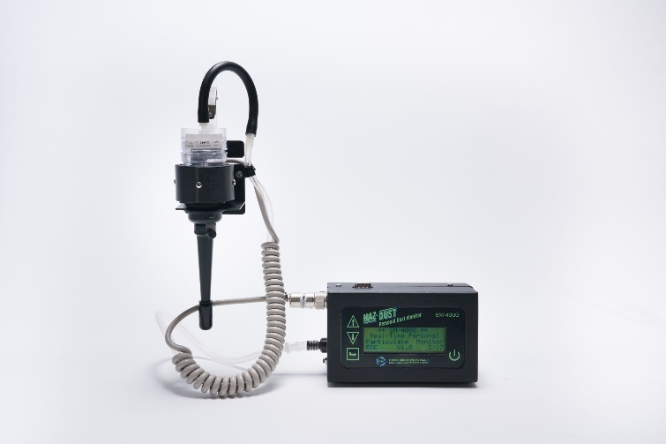
SM-4000 monitor from skc supplements compliance sampling
Sensor is placed in the breathing zone for personal samples
Can place on a small stand for monitoring regulated areas
Can measure dust levels down to 1 ug/m³

Slide 70
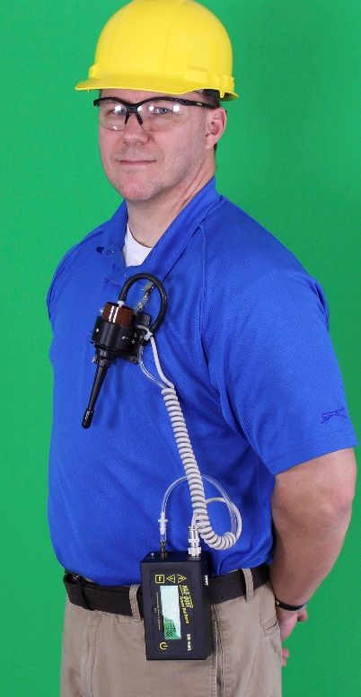
ADDITIONAL FEATURES
SM-4000 PERSONAL SILICA MONITOR
Displays and data logs dust levels.
Has an internal pump that allows users to also collect a filter sample for analysis.
Allow for attachment of only the GS-3 respirable dust cyclone.

Slide 71
FINAL THOUGHTS:
WHY BUY PUMPS WHEN FREE PUMP LOANS ARE AVAILABLE FROM LABS?
You are ready to sample any and all operations at any time with no waiting for loaner equipment to arrive.
You are ready to sample side-by-side with OSHA should they knock on your door.

Slide 72

Thank you for your interest
Contact skctech@skcinc.com or your local SKC representative with any questions.
www.skcinc.com

